Slide 1
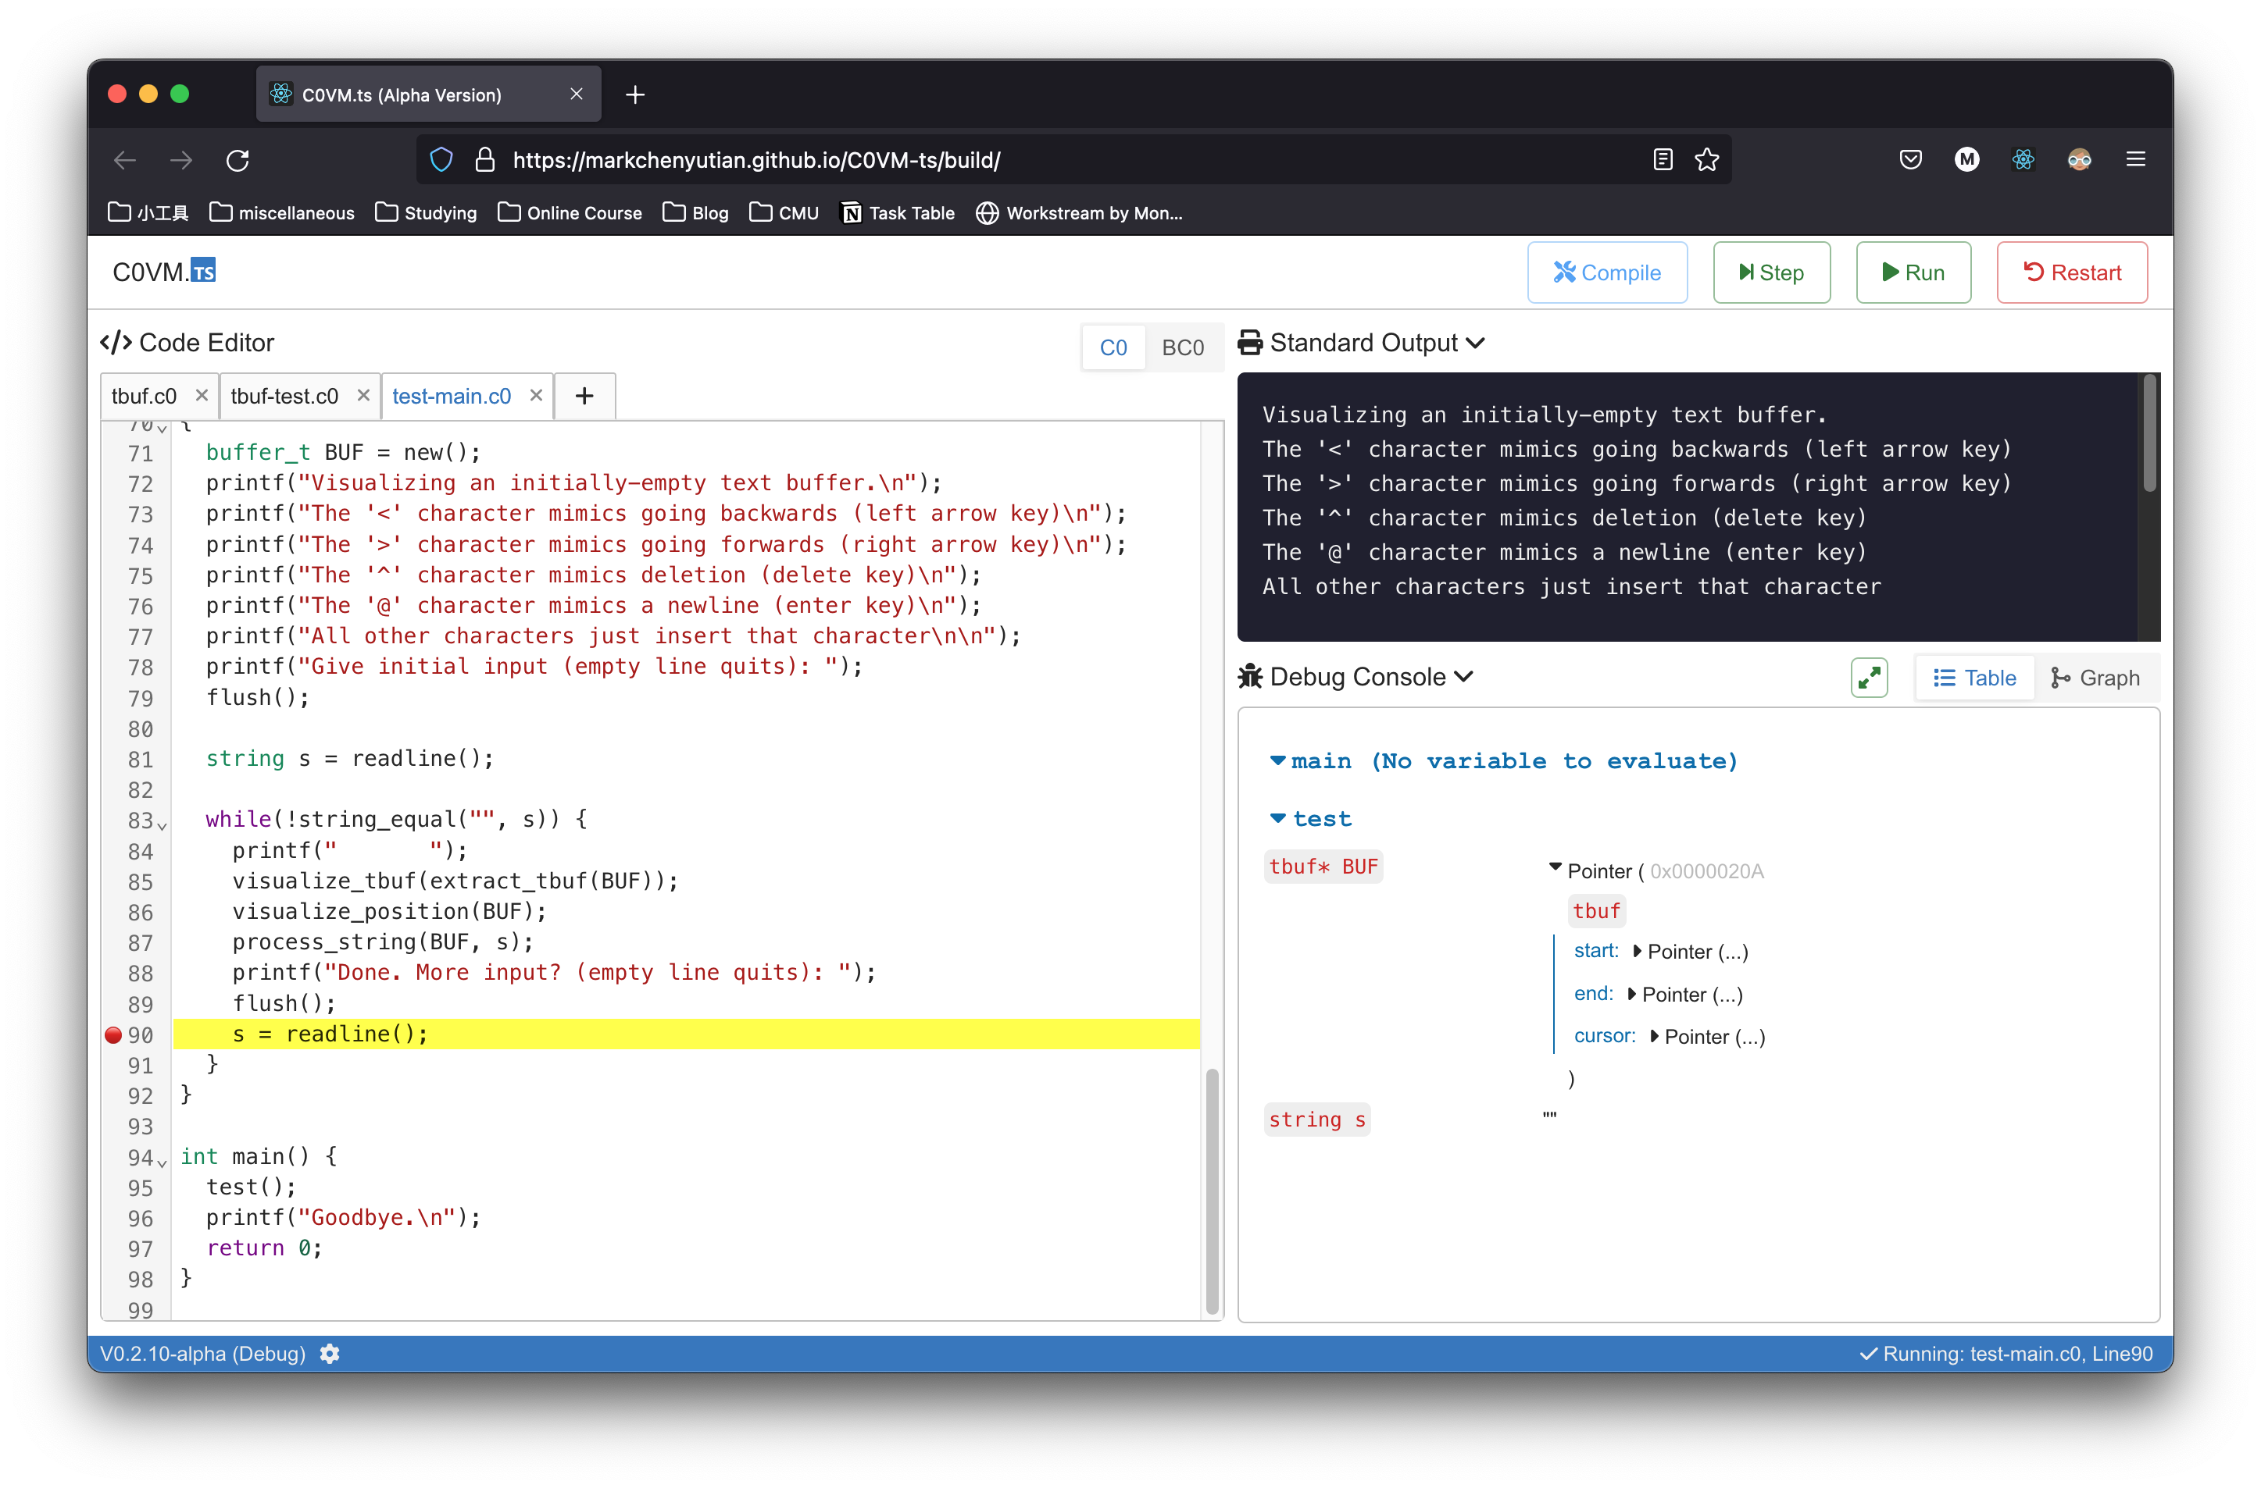
Output / Debug Area
Main Control Bar
Editor Area
Tabs
Last Line Executed (Highlighted)
Breakpoints
Release Version
Settings
VM Status Indicator

Slide 2
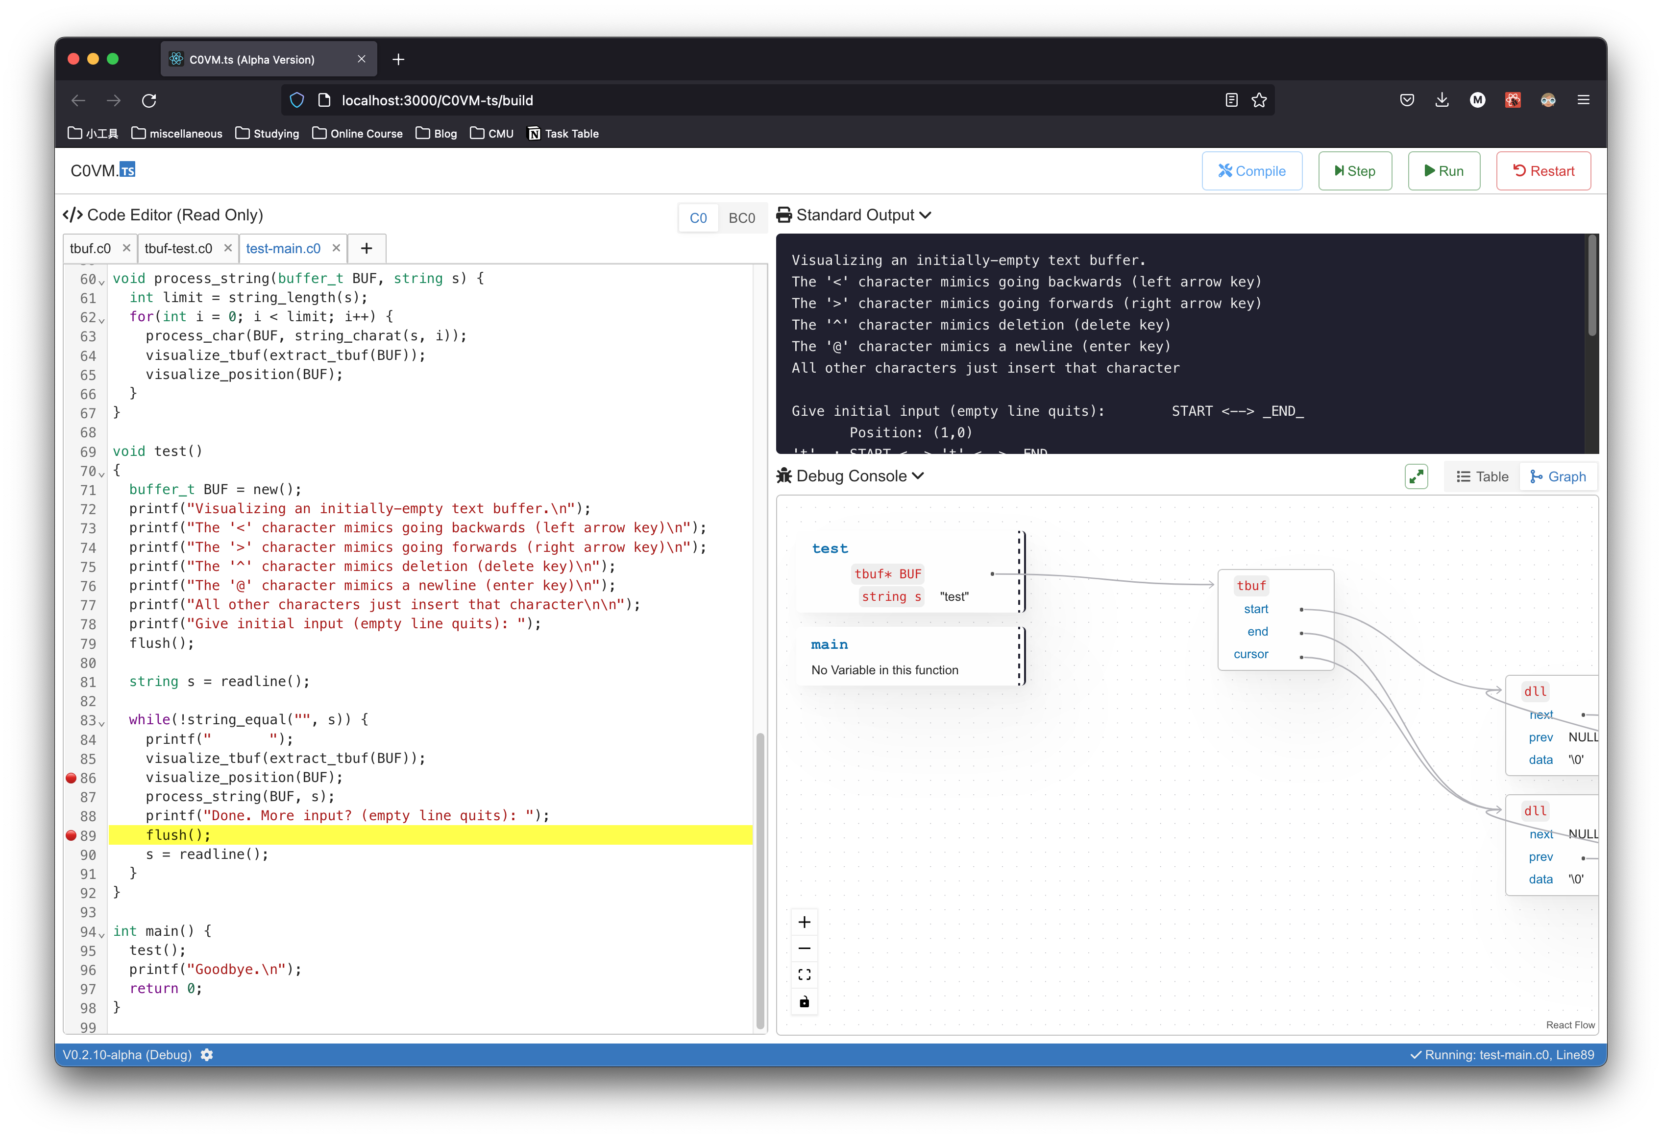
Debug C0 Program
Painful time to debug your code with approaching due?
Add breakpoint at wherever you want and see what’s happening behind the curtain step by step.

Slide 3
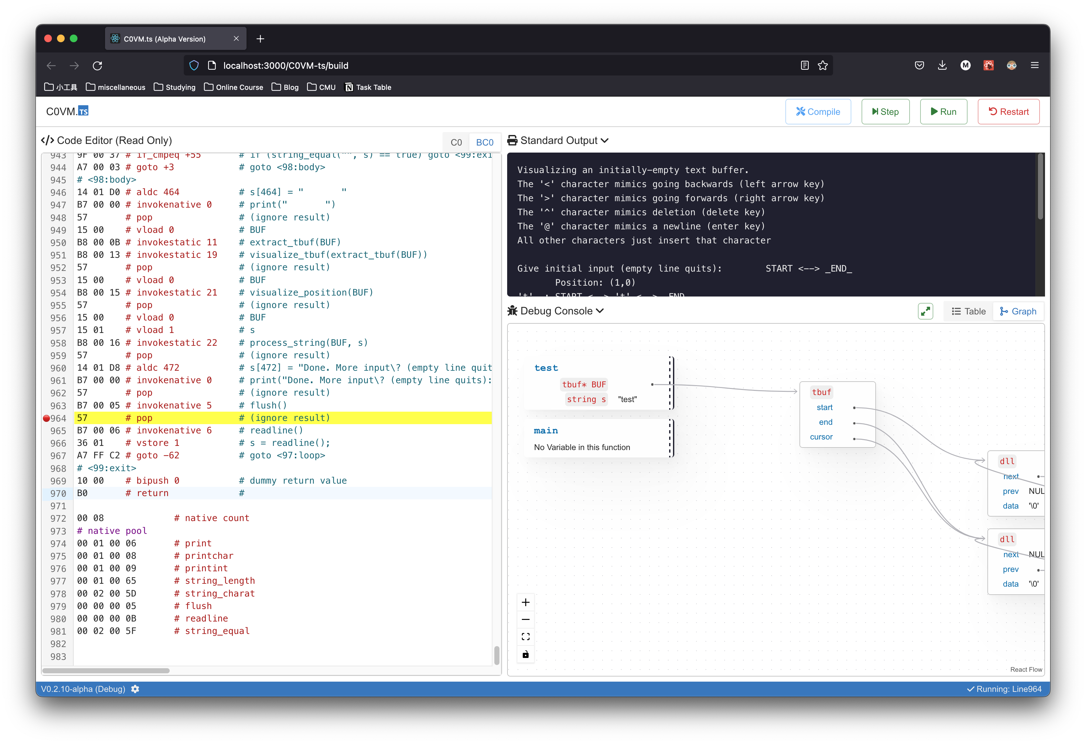
Debug C0 Bytecode
Want to understand the real power of C0VM?
Upload your bytecode and execute them on the browser, see how every tiny bytecode instruction build up into marvelous things.

Slide 4
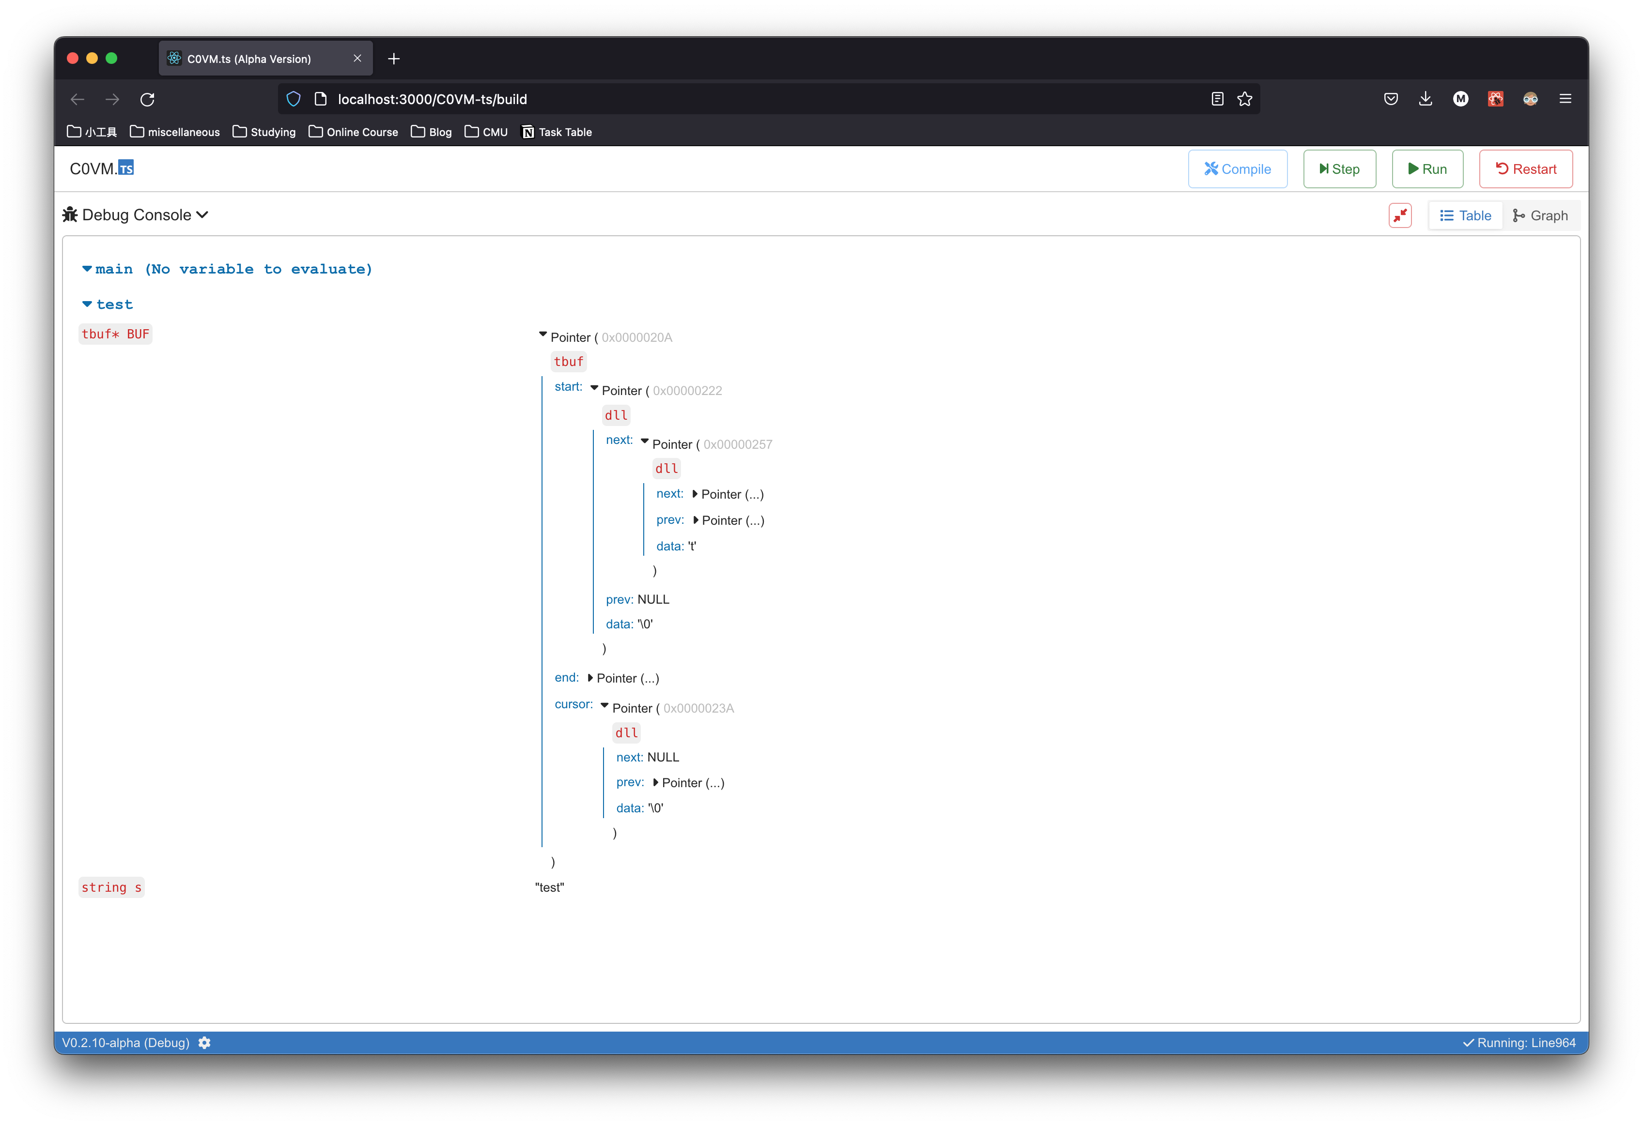
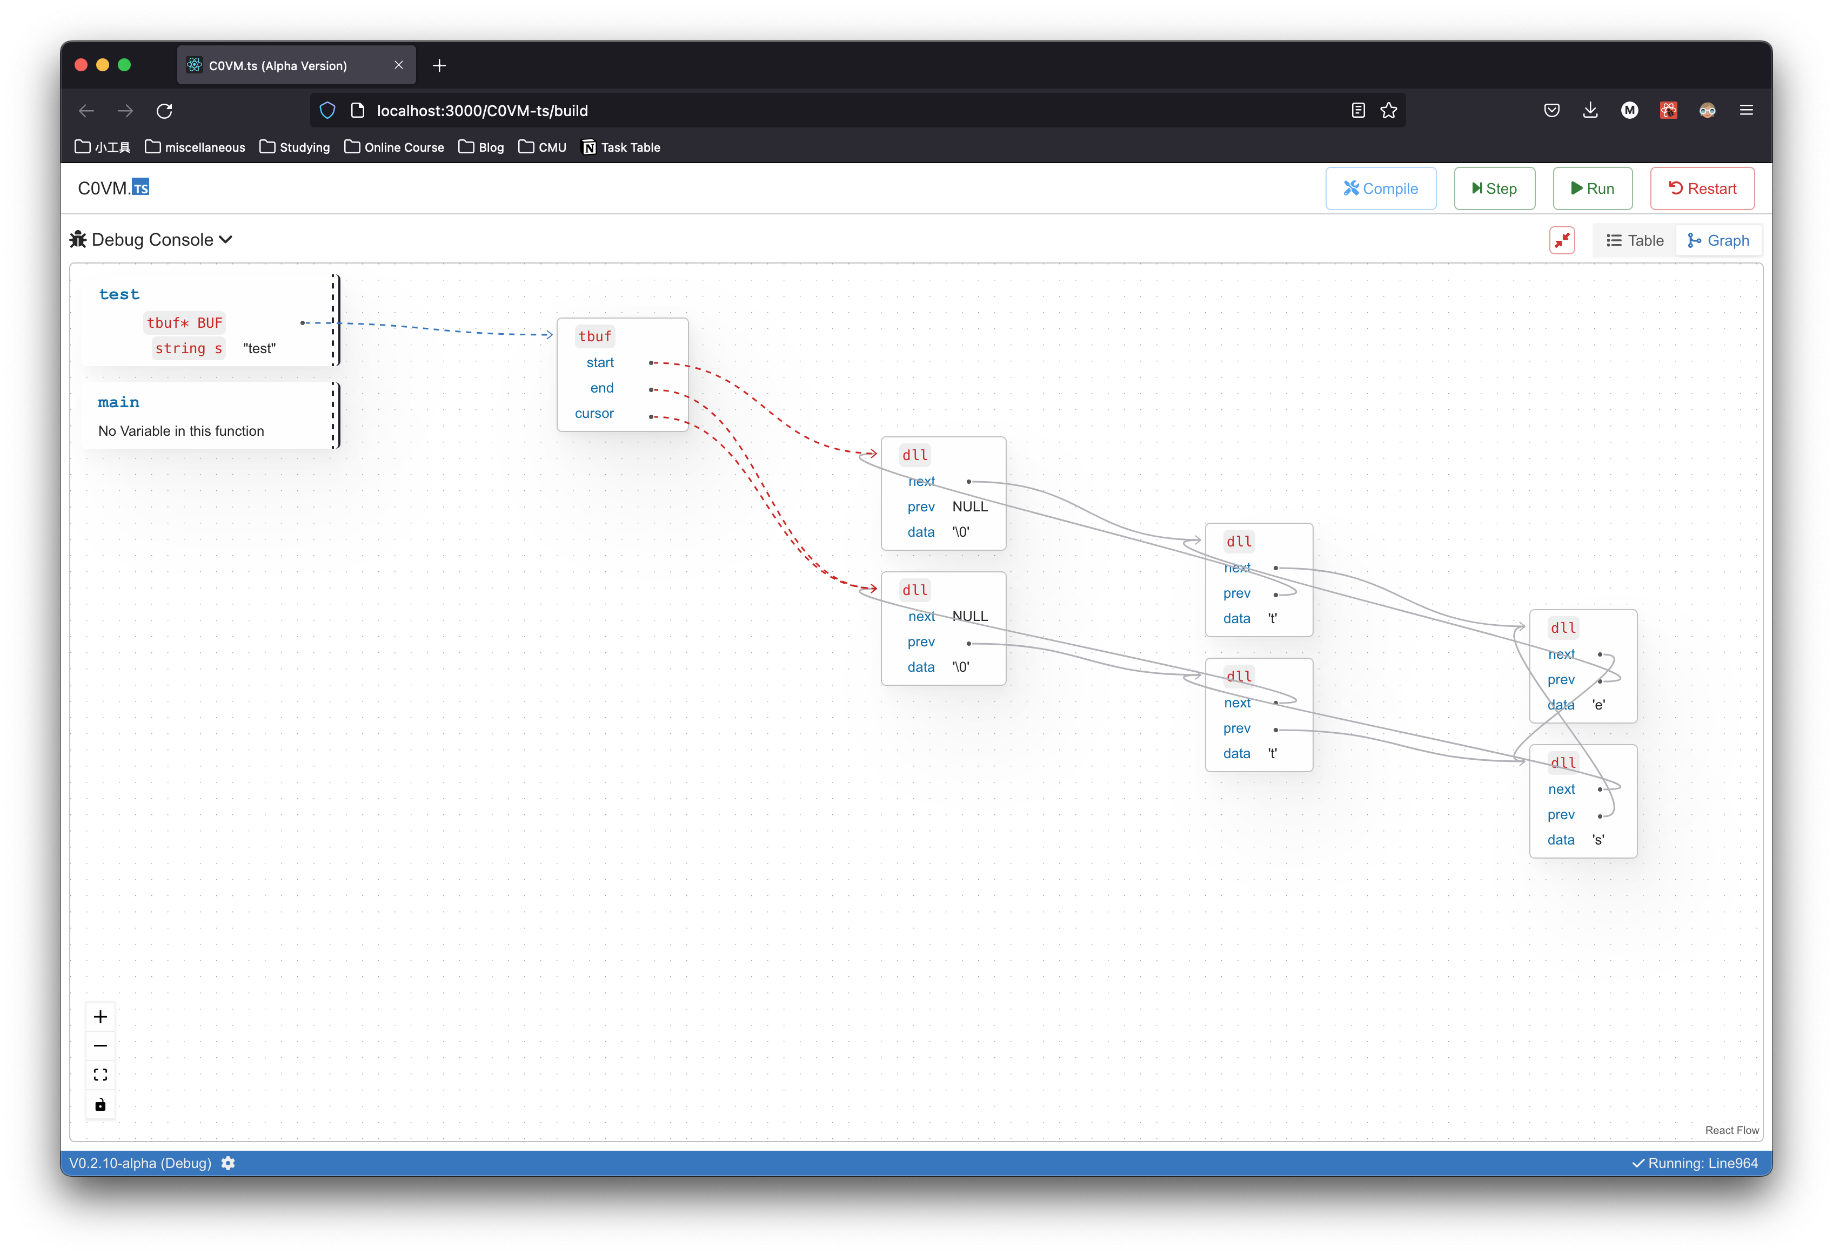
Debugger and Visualizer,
All in One
Confused with Pointers and Allocated Memory Space? Bored with adding print everywhere?
See the values of variables by table or by the graph, you got the superpower to see through everything.

Slide 5
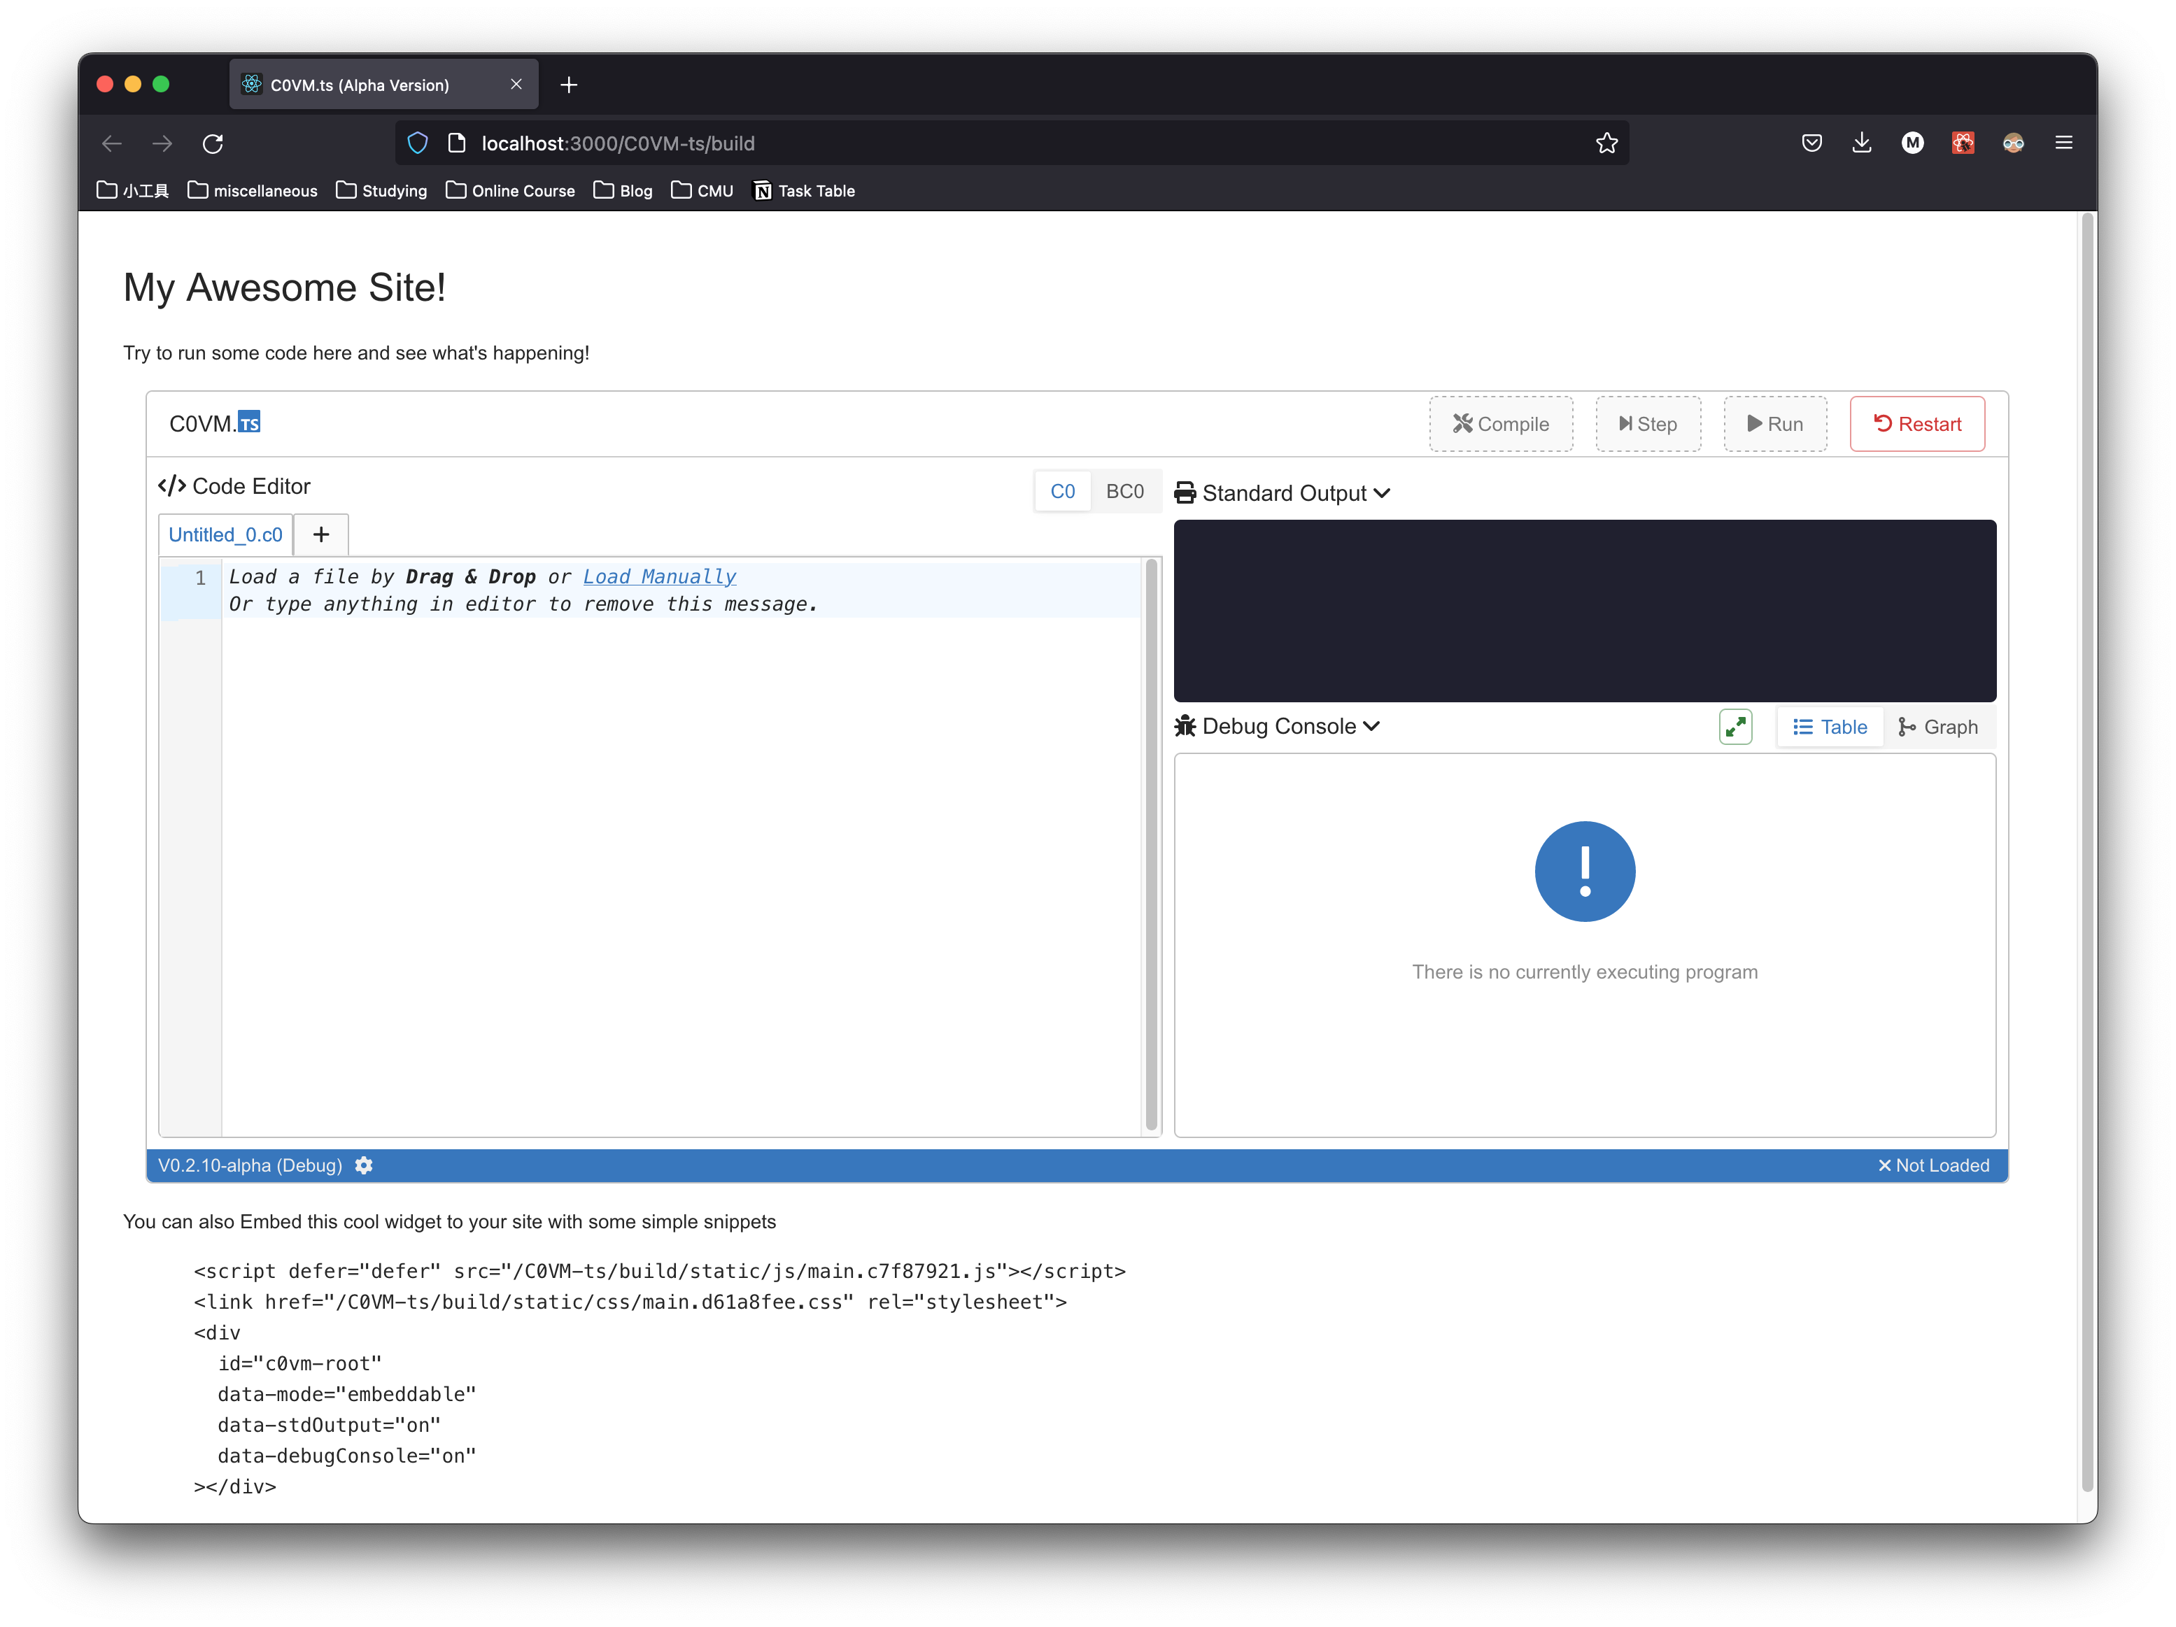
Embeddable Everywhere
Want to add interactive code demo for your awesome site?
C0VM.ts is self-contained and can be embedded in almost any website by adding less than 10 lines of code.

